Slide 1

Case Study Report
Software Ingineer Student grp121-23-3 of
Dnipro University of Technology
Danylo Dmytrovych Khimich

Slide 2

Executive Summary
1.This goal is to demonstrate what is said in the report itself.
2.Well, te problem is to understandthe presentation itself.
3.Explain and put it into perspective.

Slide 3

Introduction
1.It inspired me, because my soul felt it, to make such a report.
2.All problems can be solved, but sometimes it happens only in emergency cases.
3.When developing, you need to follow certain rules and know the right measure, and do everything on time.
4.My advice is to do everything on time and be on time.
5.My recommendations are truly subject to me, because I checked them in time.

Slide 4
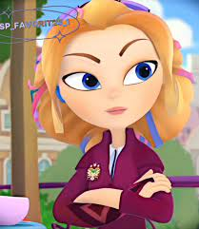
Analysis
1.Some factors help me solve another problem.
2.To begin, you need to turn on some calm music, then find a place for yourself to achieve your recommendations, and then you yourself will delve into this process.
3.It depends on why exactly it was required for certain needs.
4.The example is that when finding a solution to a problem, you need to refer to principles that will help you in some organizations.

Slide 5

Alternatives
1.In this case, you can contact specialists who will help and tell you about other solutions.
2.In this case, you need to use some tables that can be used to find a solution and also for evaluation.

Slide 6
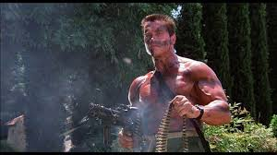
Recommendation and Implementation Plan
1.Drawing recommendations:
a)I develop websites to order.
b) This may take some time and a certain number of steps.
с)A powerful laptop and the programmer himself, in my case.
2.Plan Description
a)I will be responsible for all of this.
b)At a certain time.
с)It depends on how much this work is valued.
d)There will be a huge audience and a ton of fans, and the most popular work.
е)In this case, don't panic, but turn on some calm music and thoughts about solving some short problems will appear, even with your partner.

Slide 7

Conclusion
1.He talked about the principles of action and problem solving.
2.You need to be on time and do everything on time.
3.Thoughts on recommendations:
1)So that some people in the future know that my recommendations are useful for life.
2)It turns out that if my recommendations are very popular, it means that I am respected and loved.
3)My benefits have increased by 80 percent.

Slide 8

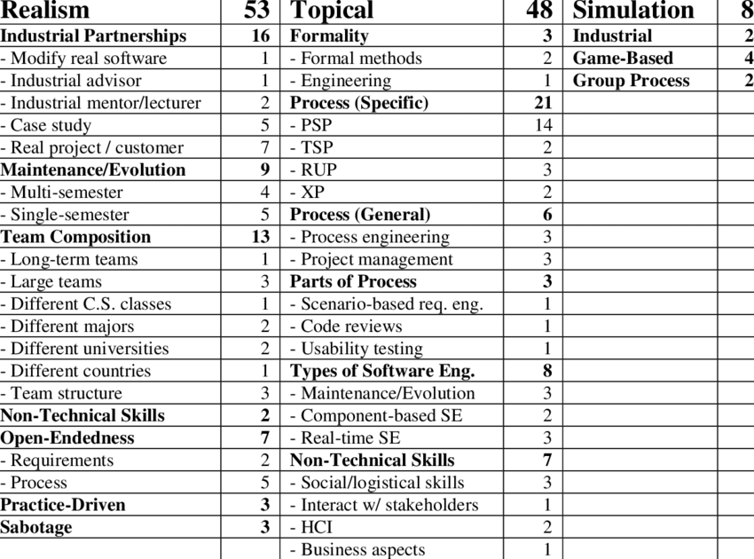
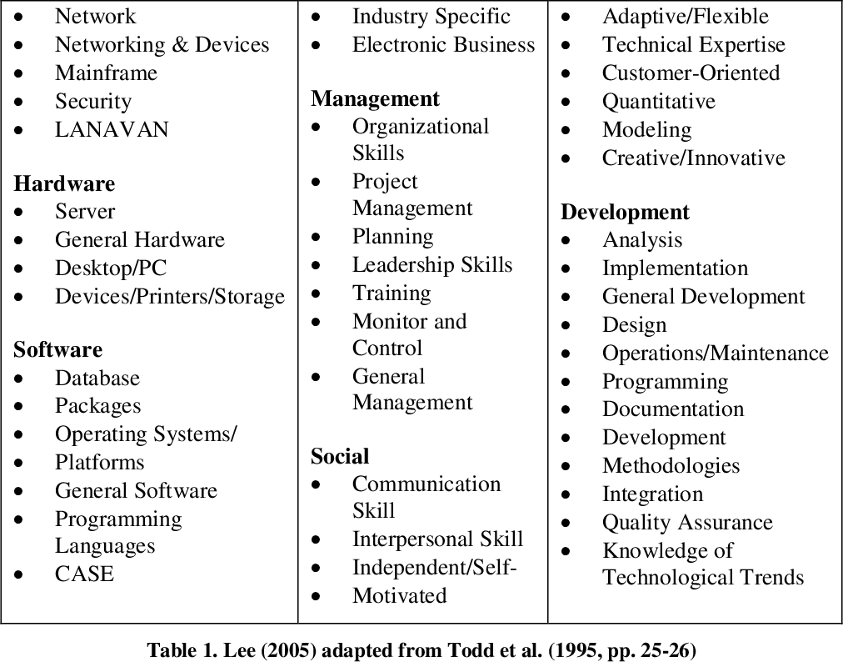
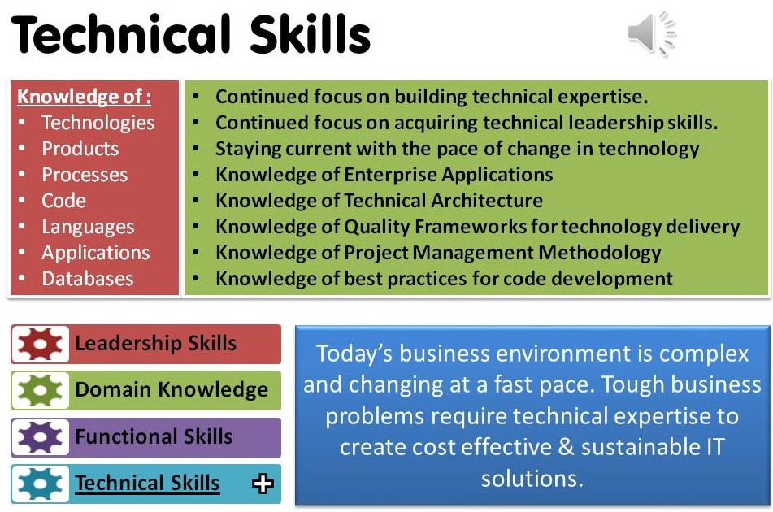
Exhibits
As we can see in this slide, the diagrams shown and some knowledge that will help in creating a website and even solving problems.

Slide 9

References
https://neoversity.com.ua/ru/blog/software-engineer-hto-ce-shcho-robit-i-de-comu-navchayut
https://campus.epam.ua/ua/blog/605
https://javarush.com/groups/posts/316-kto-takoy-software-engineer-programmnaja-inzhenerija-vs-programmirovanie
https://neoversity.com.ua/?utm_source=google&utm_medium=cpc&utm_campaign=IL_MNeo_Search_4&utm_content=it_specializations2&utm_term=software%20engineer&placement=&campaignid=23081597261&gad_source=1&gad_campaignid=23081597261&gbraid=0AAAAA-MxBTi2Wpod1U2R0LVUuGLsNCsFt&gclid=CjwKCAiAlfvIBhA6EiwAcErpyTe1l0FJbMXO40Q9m7WCYMkvp8DlzN3edaatBbCd0zUt9cMZDSBjnxoCxg0QAvD_BwE

Slide 10

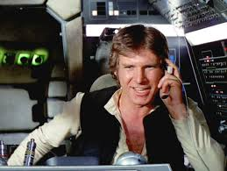

Thank you for listening to my presentation about the sciences and technologies that surround us!

